Slide 1
FOOD GALORE
BY- GROUP 2 (The Misfits)

Slide 2
.
Work In Progress
Team Members:
Aayush Lal Rajbhandari
Aman Kumar Shrestha
Pratiksha Manandhar
Sanjeev Lamsal
Top Bahadur Rana

Slide 3
CONTENT
INITIATION
-PROJECT CHARTER
-MEETING MINUTES
PLANNING
-BELBIN
-SKILLS AUDIT
-MS PROJECT
-COMMUNICATION TOOLS
EXECUTION
-Entity Relationship Diagram
-Use case Diagram
-Requirement Catalogue
-Logo
-Wireframe
-Project development

Slide 4
INITIATION PHASE
PROJECT CHARTER
TEAM CONTRACT

Slide 5
Project charter
Project Charter Introduction
Project charter outlines the entirety of projects to help teams quickly understand the goals, tasks, timelines, and stakeholders.

Slide 6
Project charter
Version Control
· Project Justification
· Project Scope
· Project Assumption
· Rules & Responsibilities

Slide 7
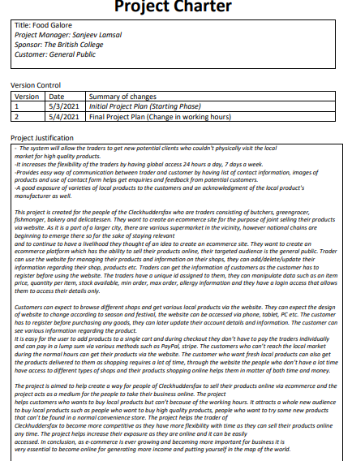
Project charter

Slide 8
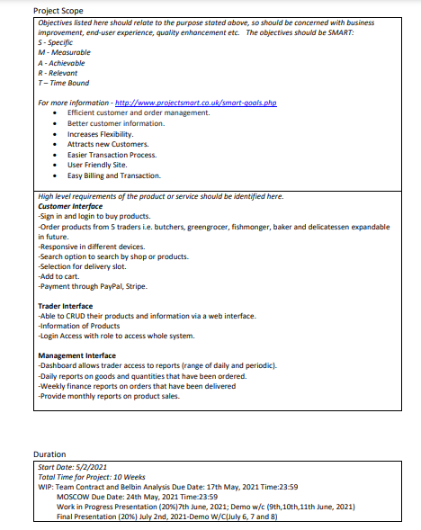
Project charter

Slide 9
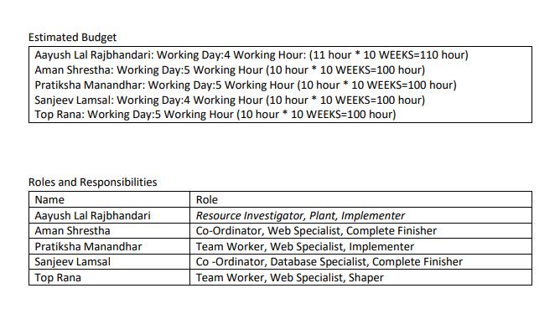
Project charter

Slide 10
Meeting minutes
Introduction
Meeting minutes are notes that are recorded during a meeting. ... The minutes of a meeting are usually taken by a designated member of the group. Their task is to provide an accurate record of what transpired during the meeting. Top Bahadur Rana was responsible for keeping the track of the time as well as taking screenshots as well.

Slide 11
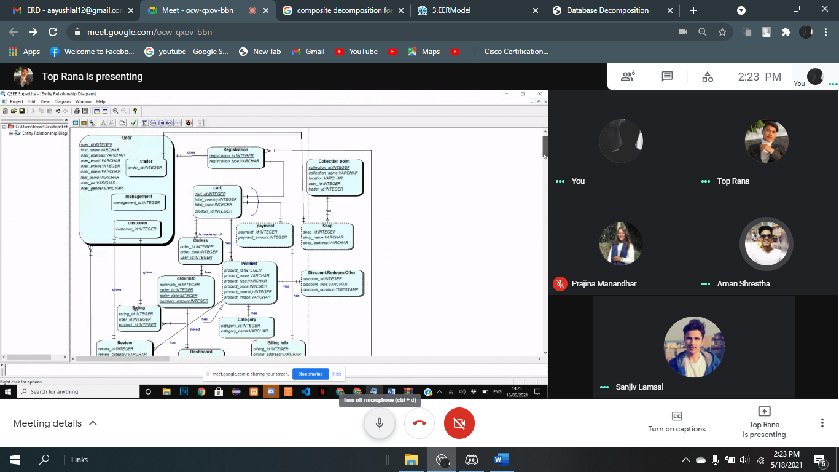
Meeting minutes

Slide 12
Belbin’s
Belbin Introduction
Belbin suggests that, by understanding your role within a particular team, you can develop your strengths and manage your weaknesses as a team member, and so improve how you contribute to the team.
Team leaders and team development practitioners often use the Belbin model to help create more balanced teams.

Slide 13
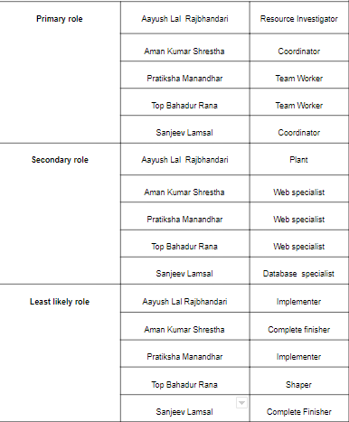
Roles

Slide 14
Individual Skill audit
Skill audit Screenshot

Slide 15
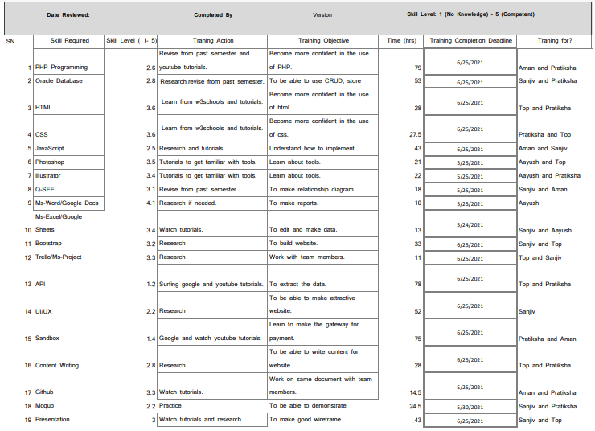
TEAM Skill audit

Slide 16
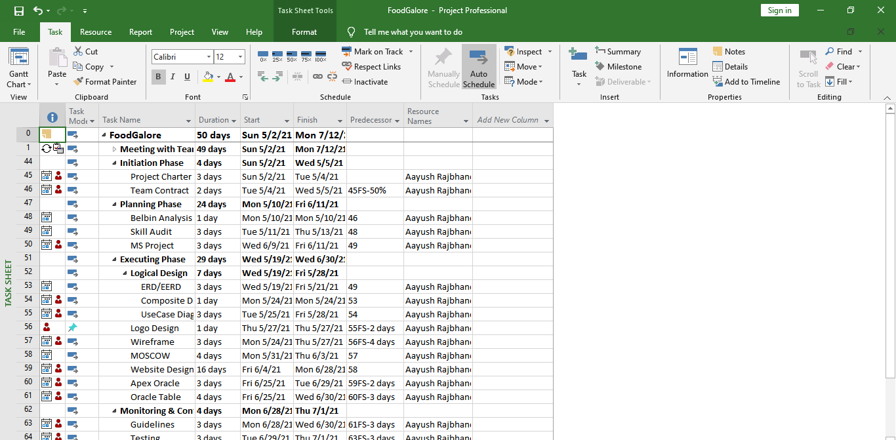
Task sheet
screenshot

Slide 17
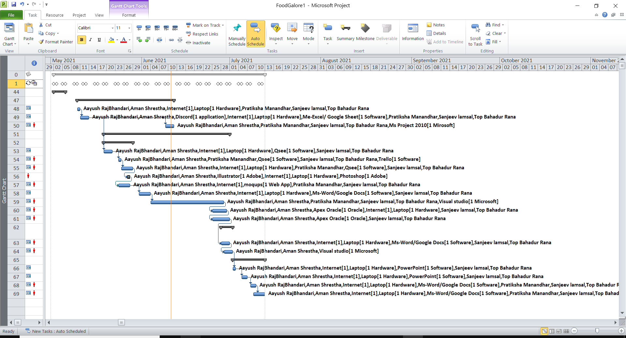
Gantt chart
screenshot

Slide 18
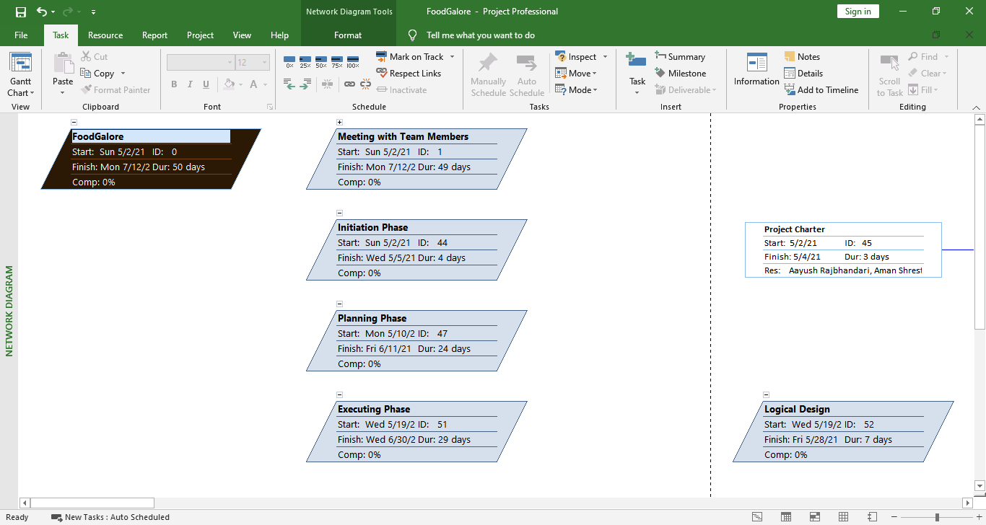
Network diagram

Slide 19
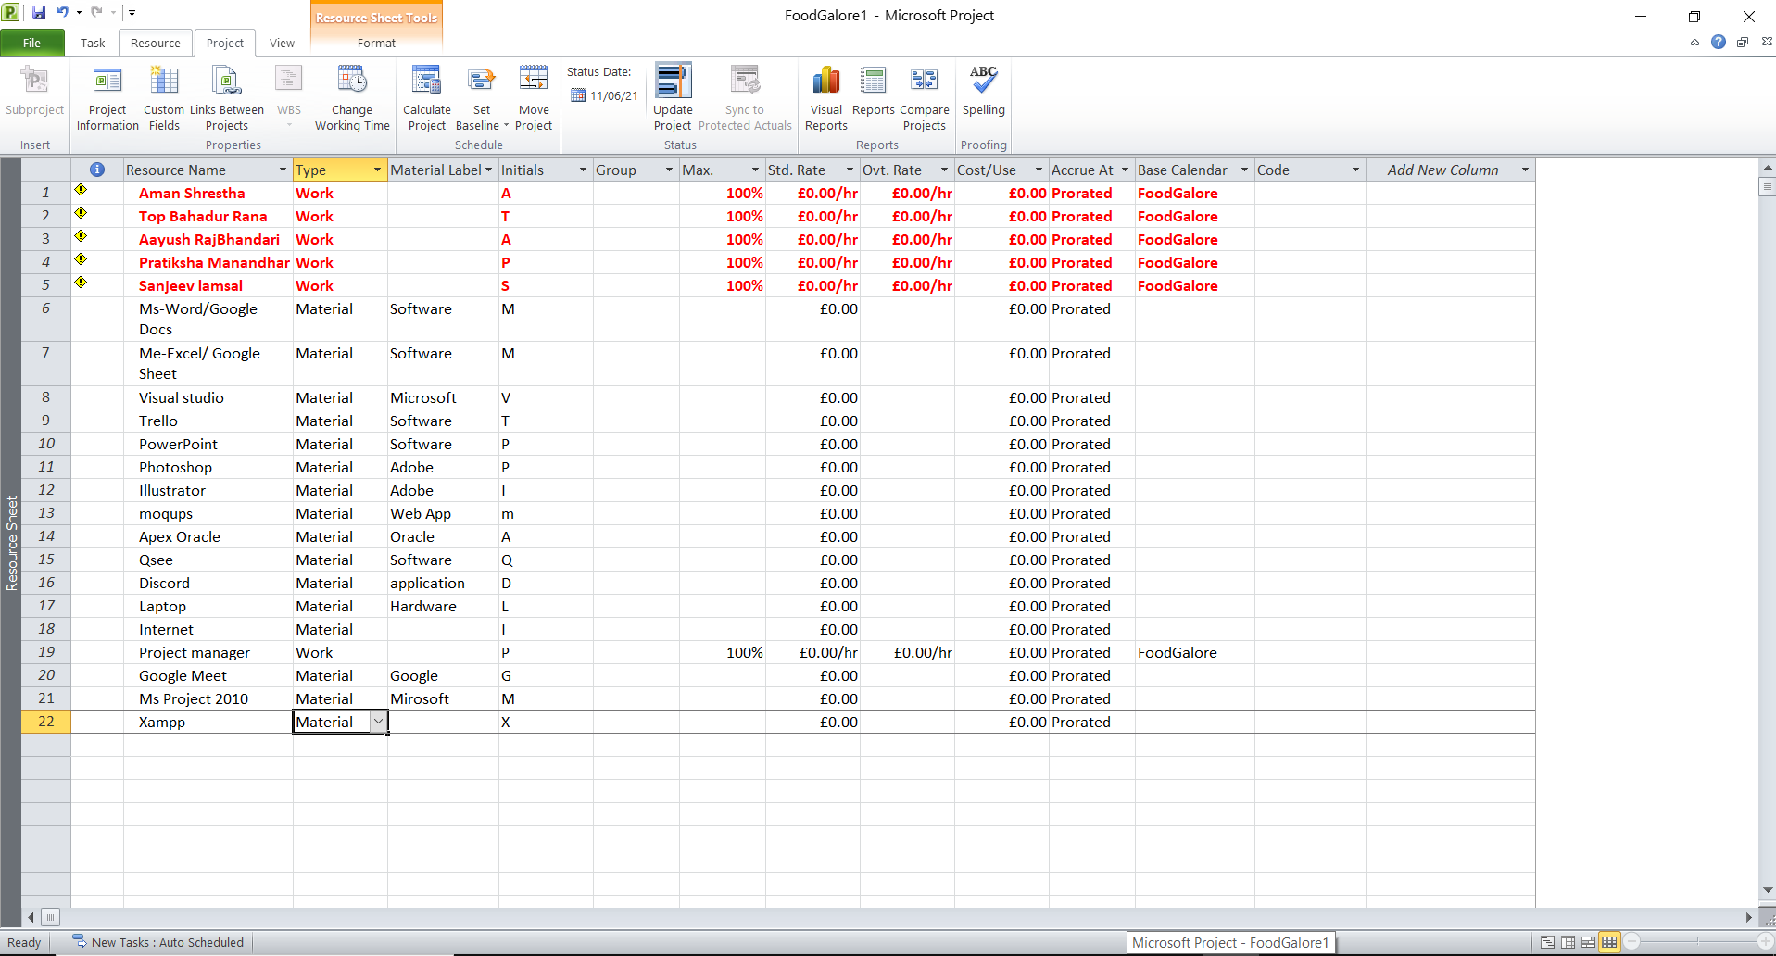
Resource sheet
screenshot

Slide 20
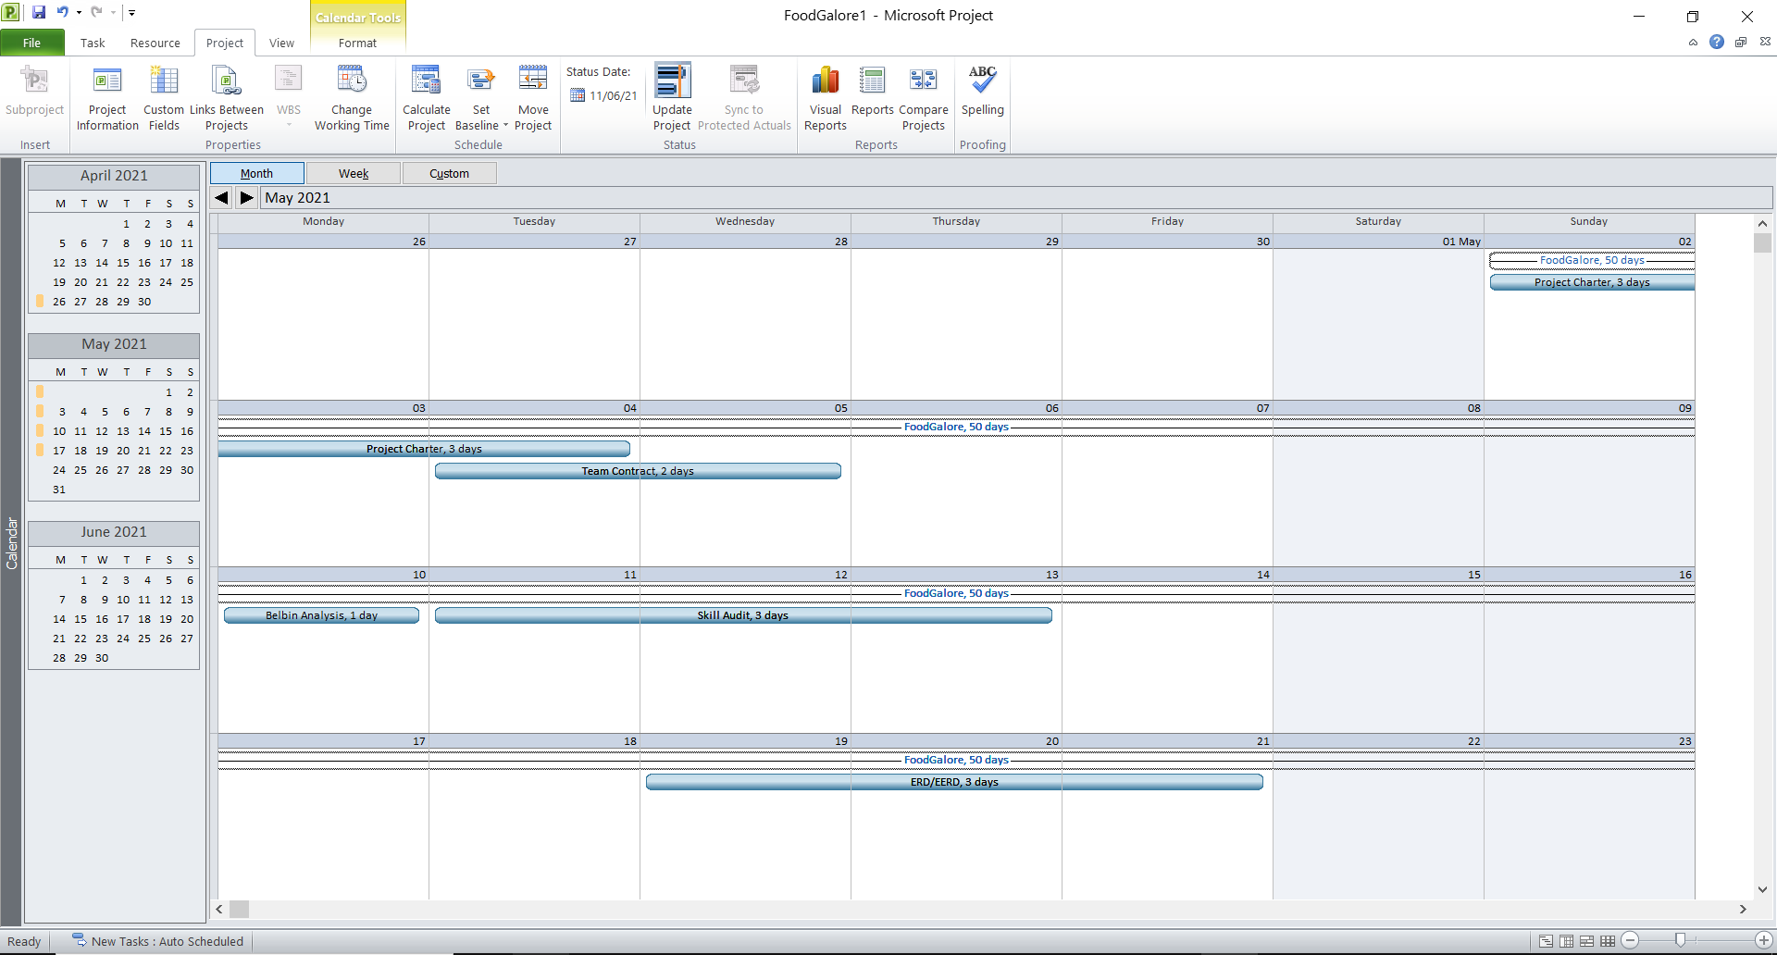
Calendar

Slide 21
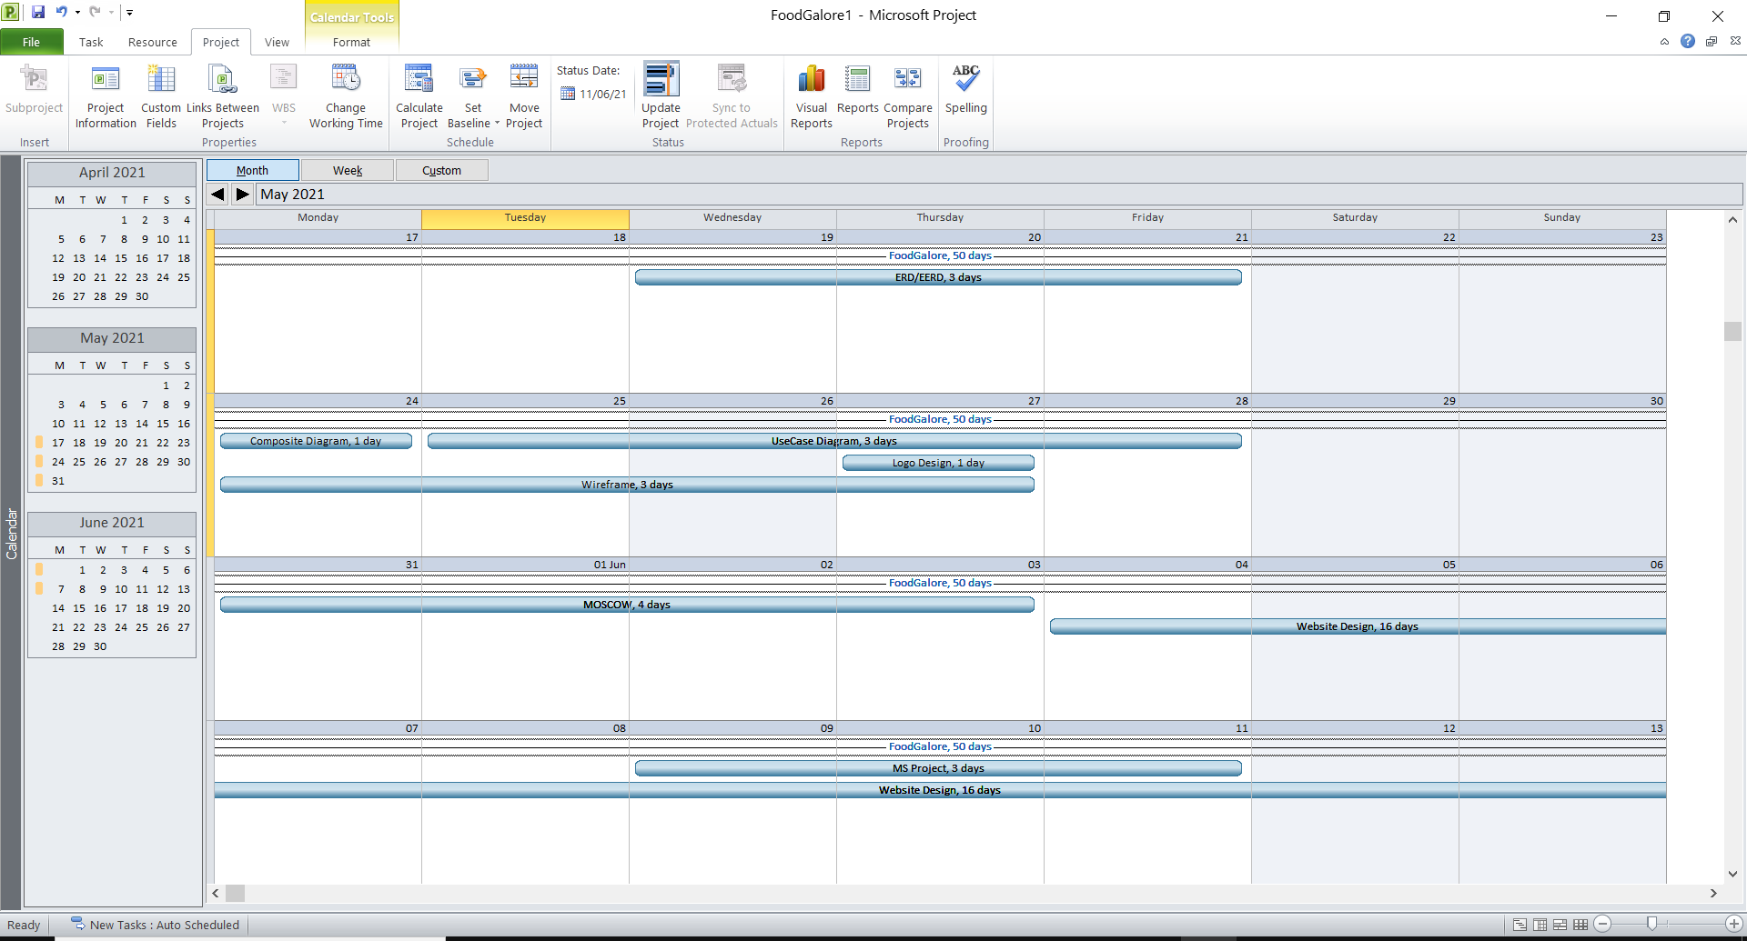
Calendar

Slide 22
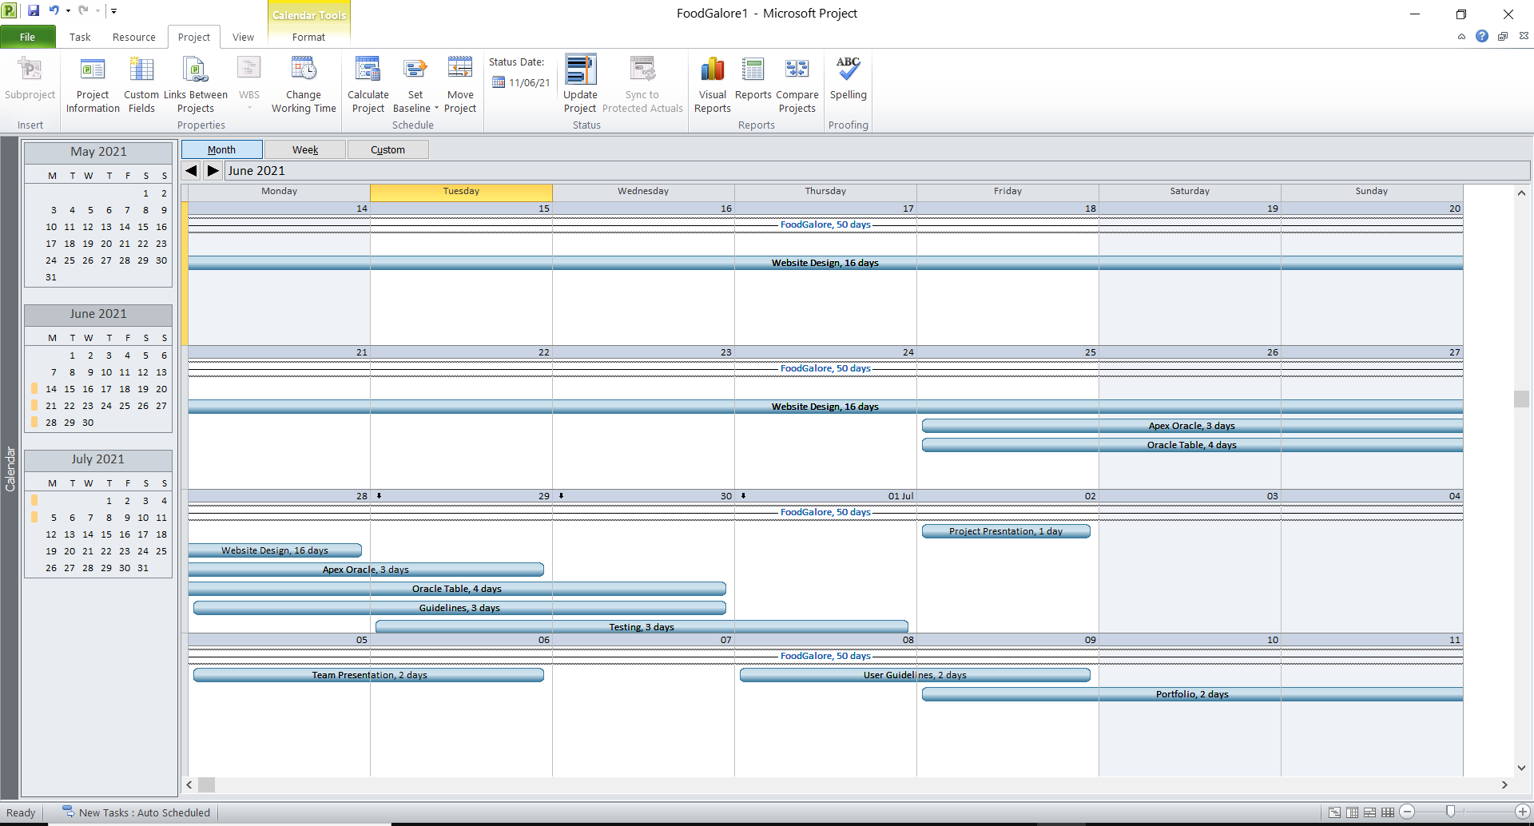
Calendar

Slide 23
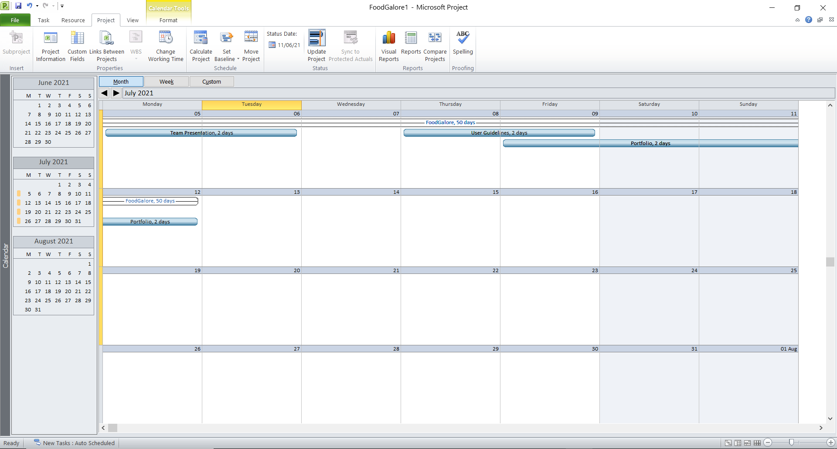

Slide 24
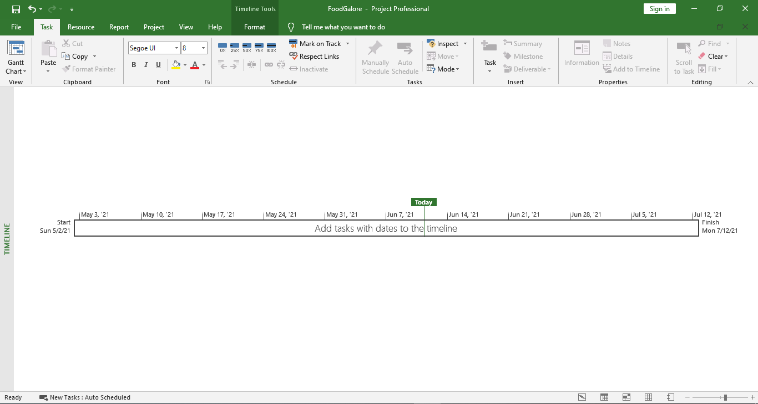
Timeline
screenshot

Slide 25
Communication tools
Usual method of Communication
Method of Communication: Discord, Google Meet
In case, any of the team member can’t solve the problem, our team is ready to communicate in any between 10 to 4pm.
Google meet link: https://meet.google.com/ocw-qxov-bbn?hs=151

Slide 26
Executing phase
ERD
EERD
COMPOSITE EERD
USE CASE
WIREFRAME
MOSCOW

Slide 27
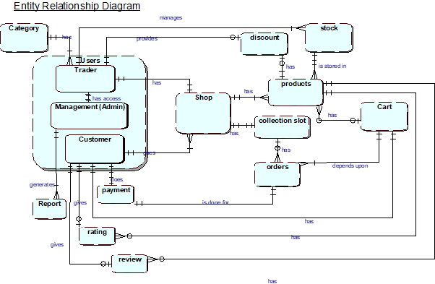
ERD

Slide 28
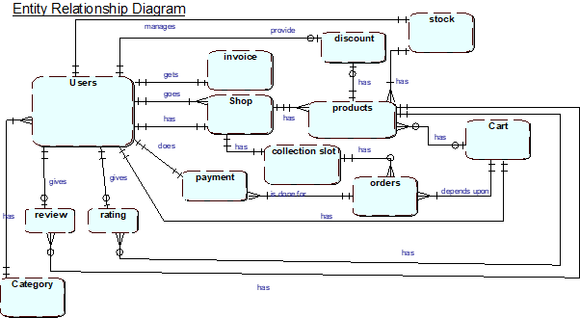
EERD
Erd ko screenshot

Slide 29
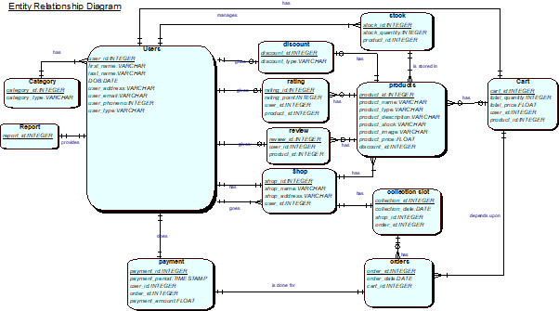
Composite EERD

Slide 30
Use case diagram
Customer
Trader
Admin
overview

Slide 31
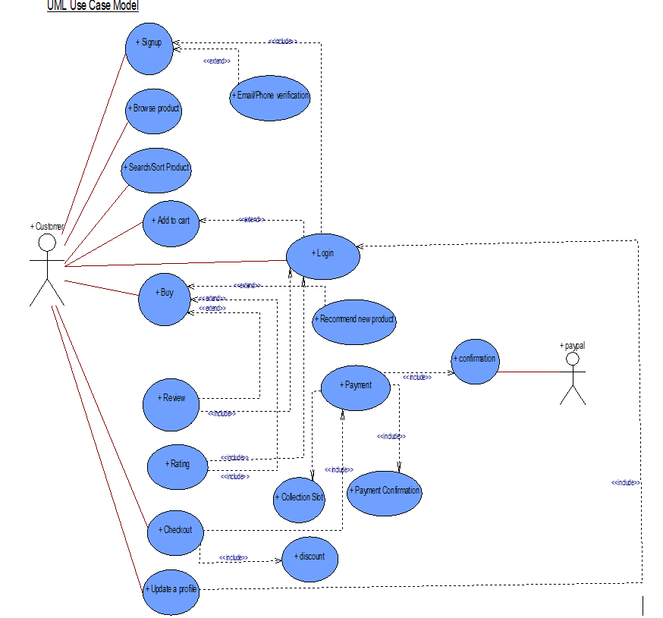
Customer Interface
.

Slide 32
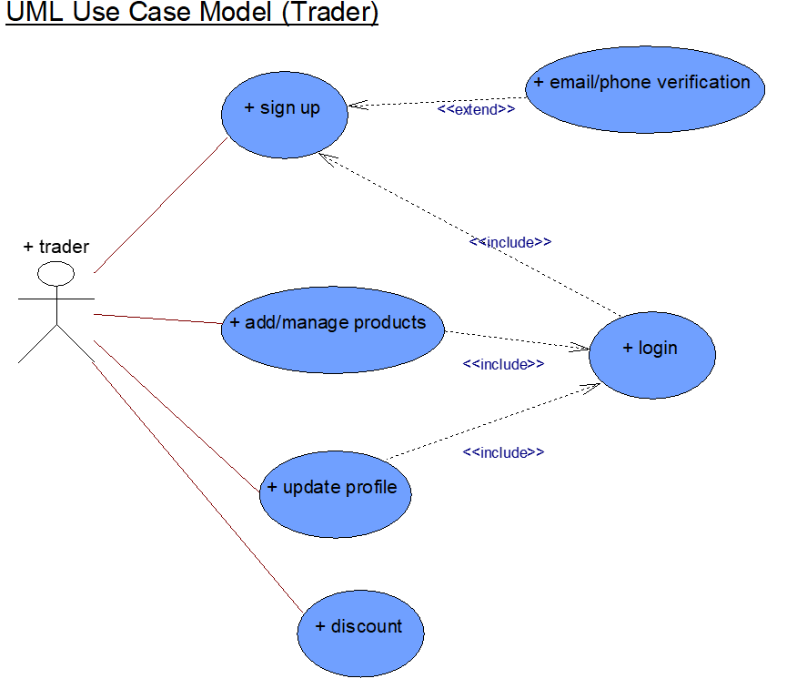
Trader Interface

Slide 33
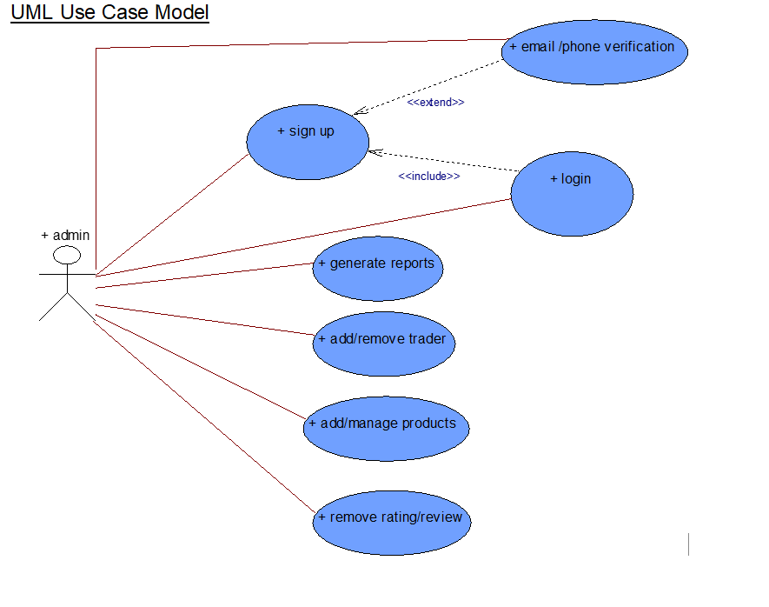
Admin Interface

Slide 34
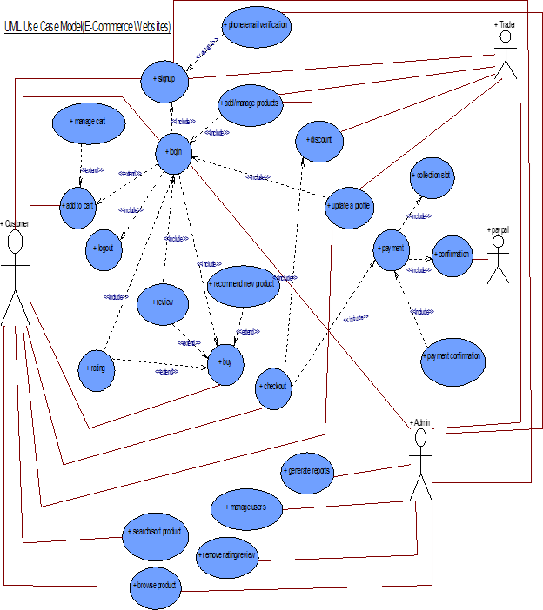
Overview ( overall)

Slide 35
Requirement catalogue
Functional requirement
Non functional requirement

Slide 36
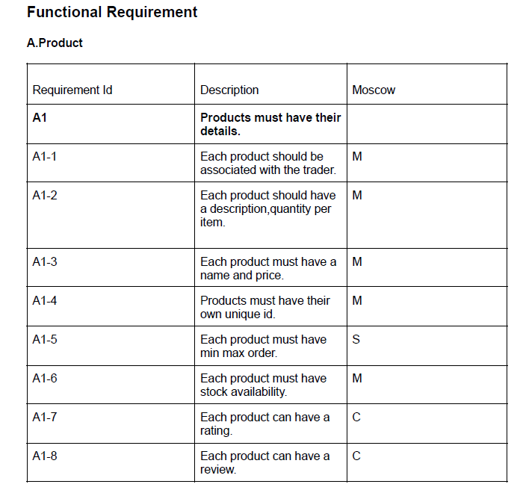
Functional requirement
.

Slide 37
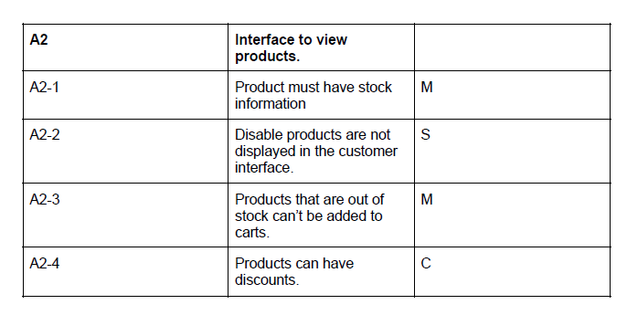
FUNCTIONAL REQUIREMENT

Slide 38
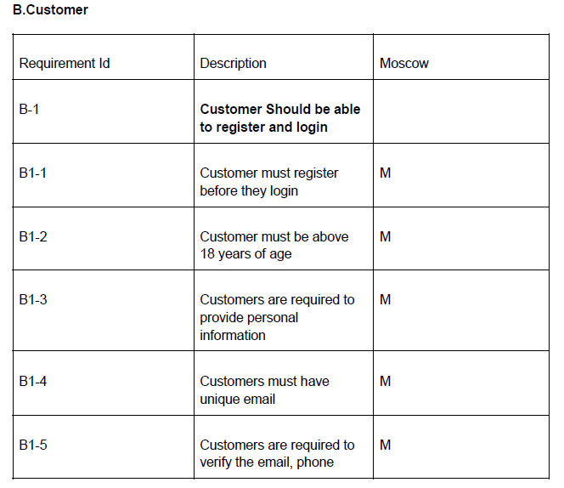
FUNCTIONAL REQUIREMENT

Slide 39
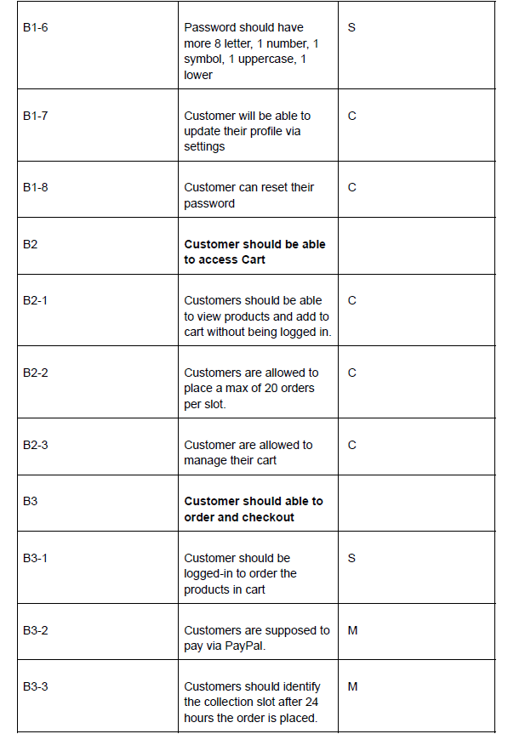
FUNCTIONAL REQUIREMent

Slide 40
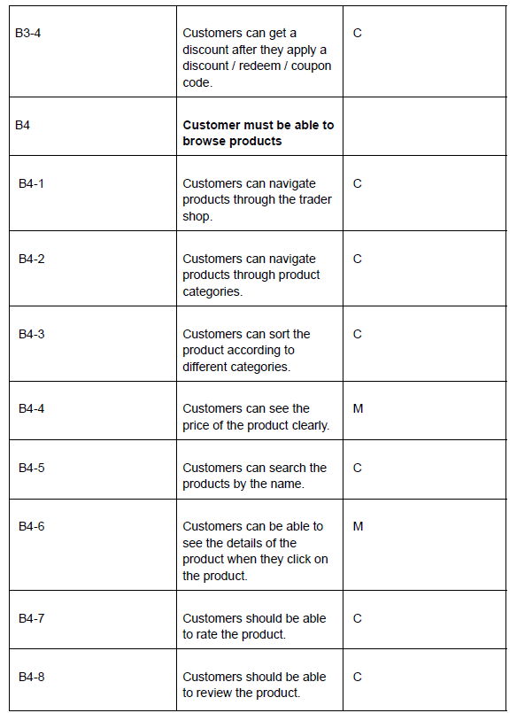
FUNCTIONAL REQUIREMENT

Slide 41
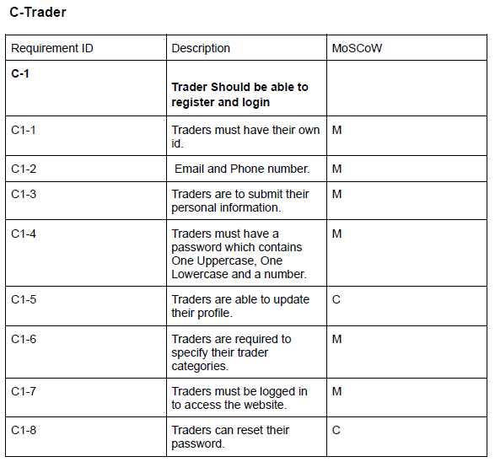
FUNCTIONAL REQUIREMENT

Slide 42
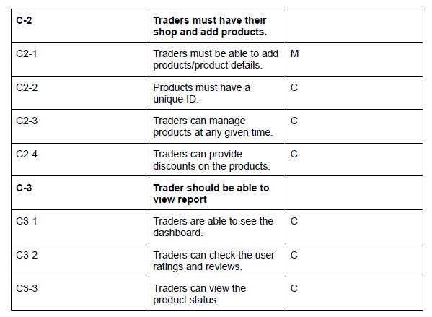
FUNCTIONAL

Slide 43
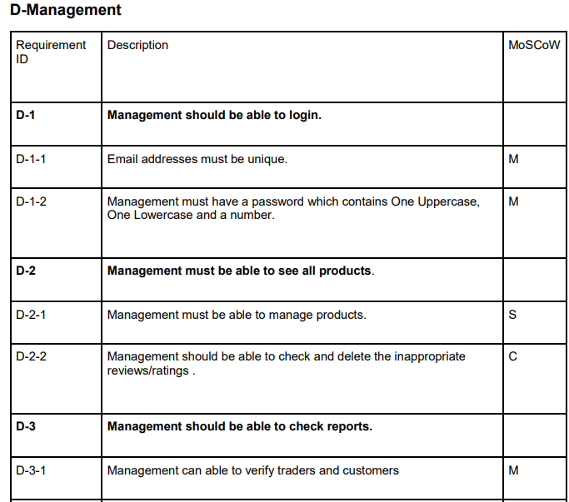
FUNCTIONAL

Slide 44
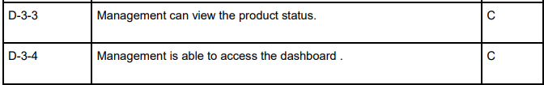

Slide 45
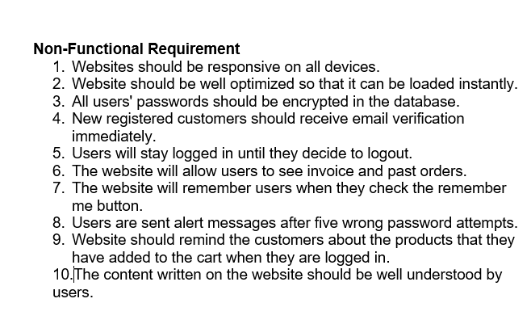
Non functional requirement
screenshot

Slide 46

Our logo

Slide 47
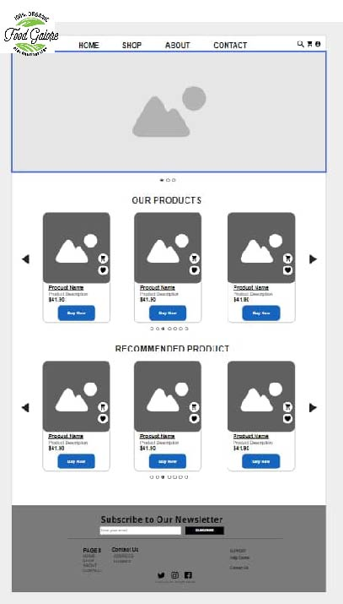
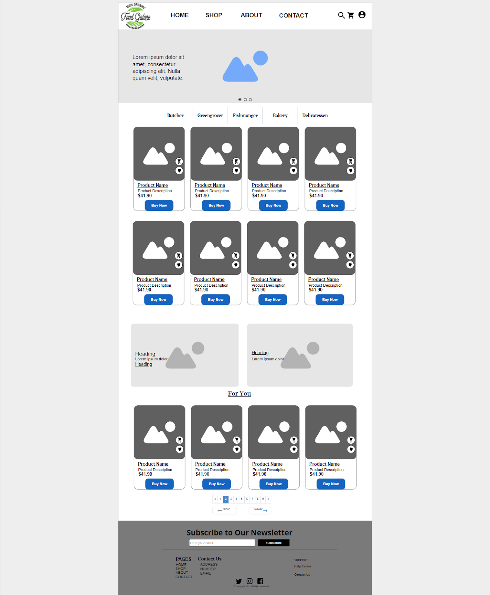
Wireframe screenshot

Slide 48
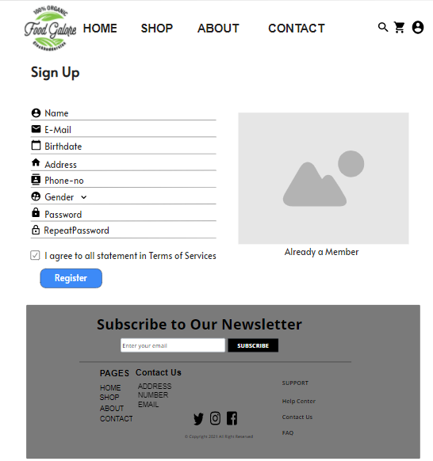
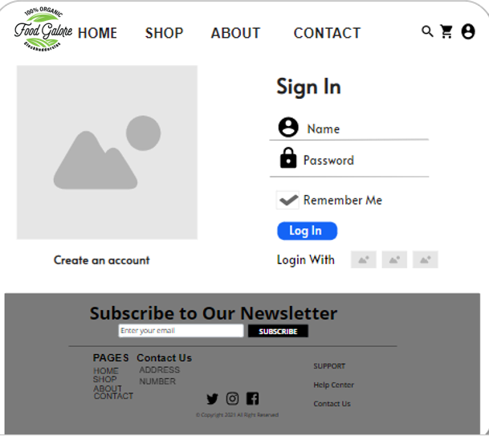
WireFrame screenshot

Slide 49
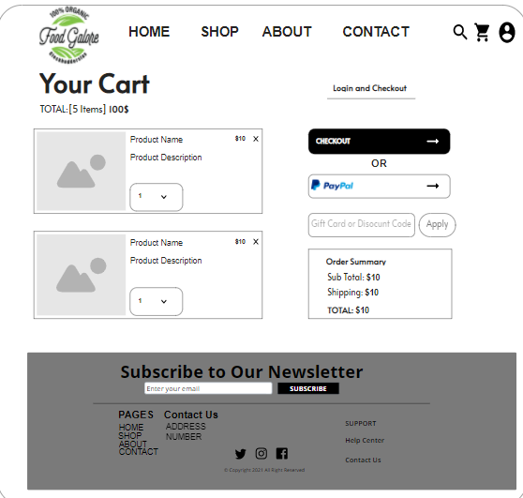
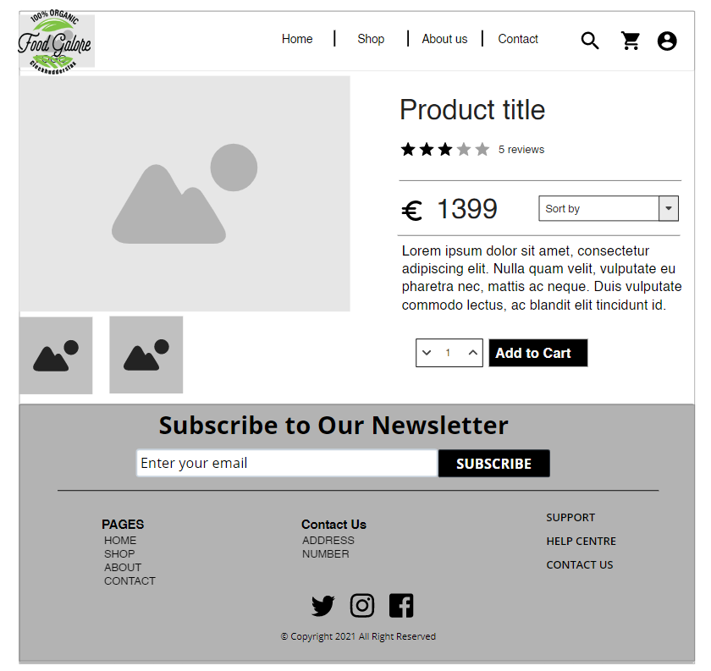
Wireframe screenshot

Slide 50
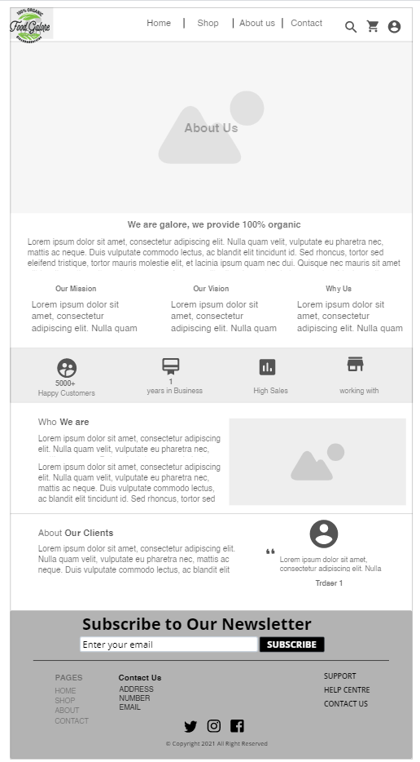
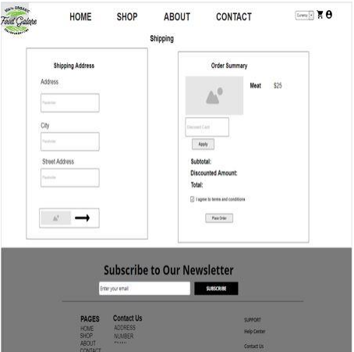
Wireframe screenshot

Slide 51
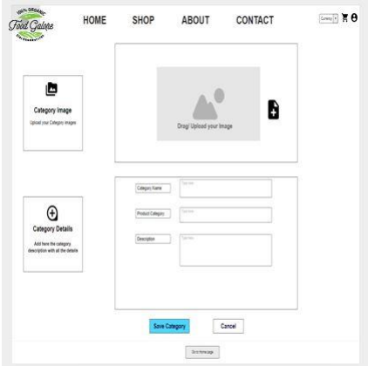
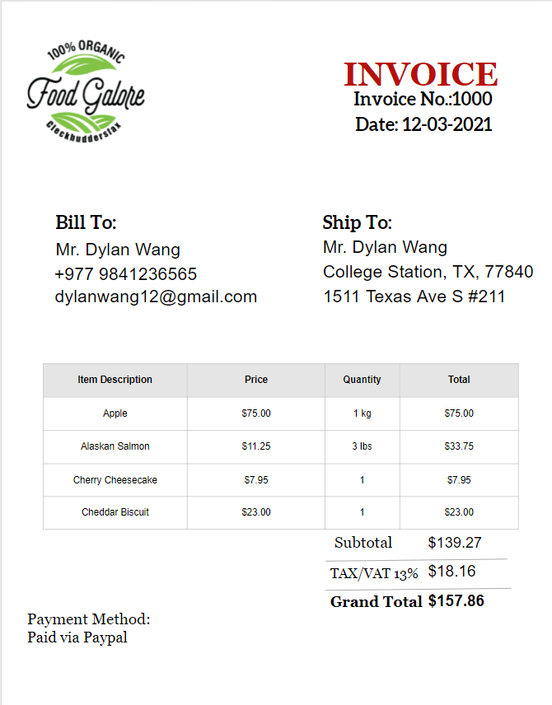
Wireframe screenshot

Slide 52
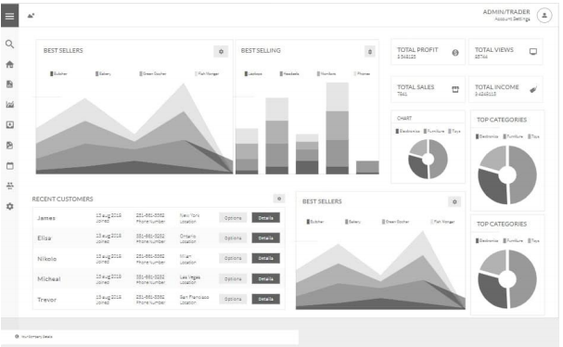
Wireframe screenshot

Slide 53
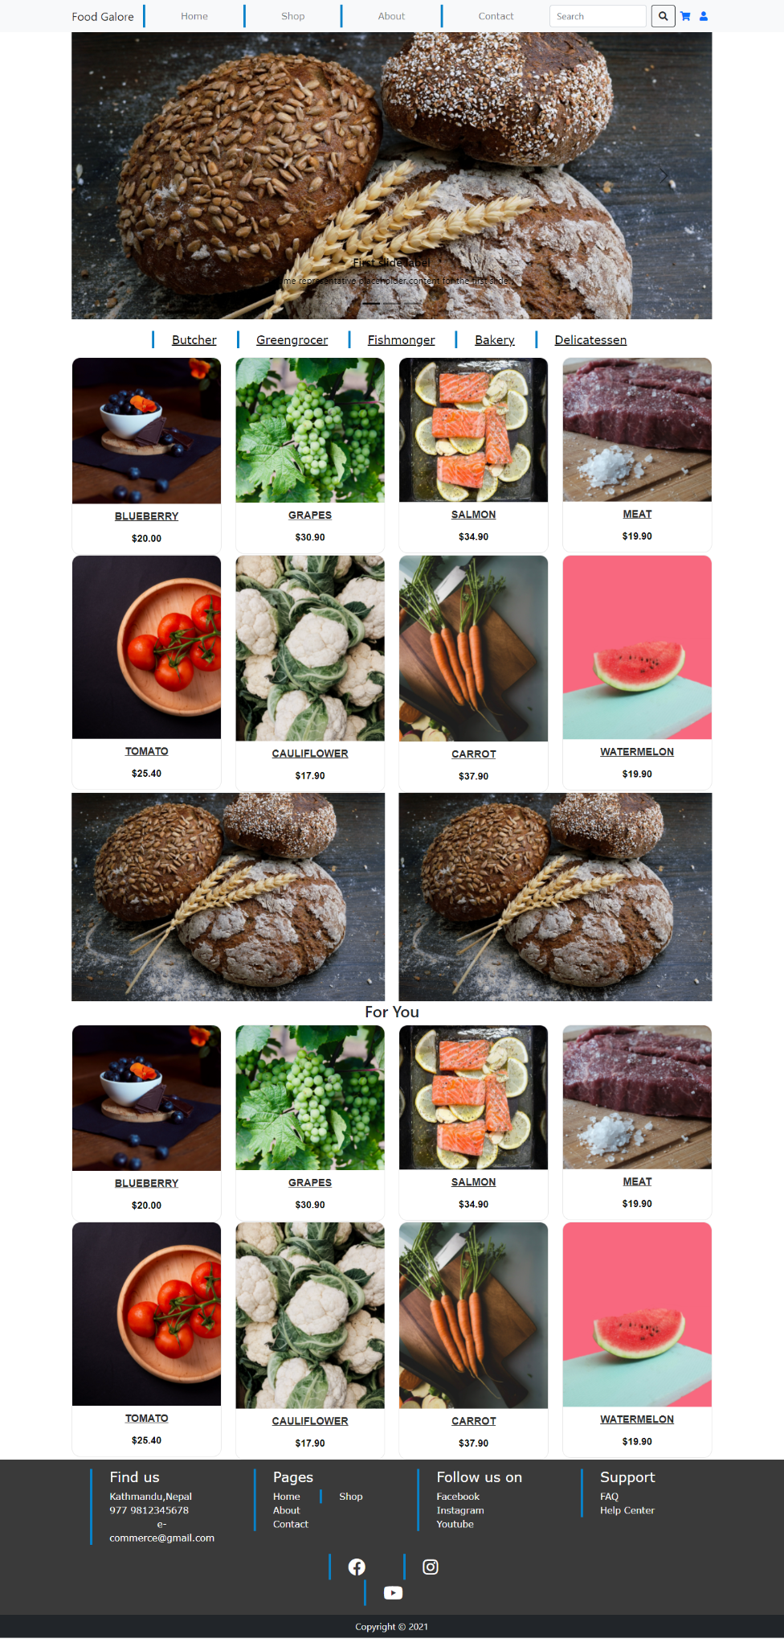
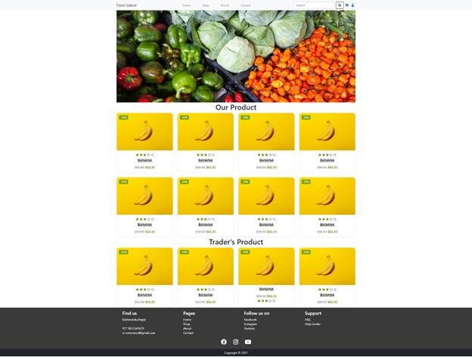
Product development

Slide 54
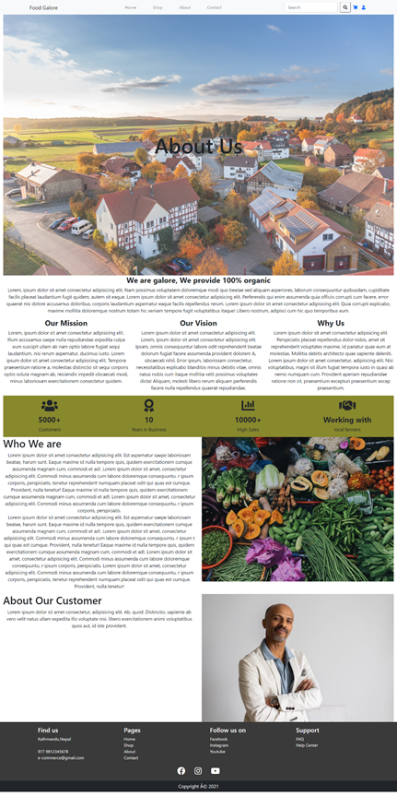
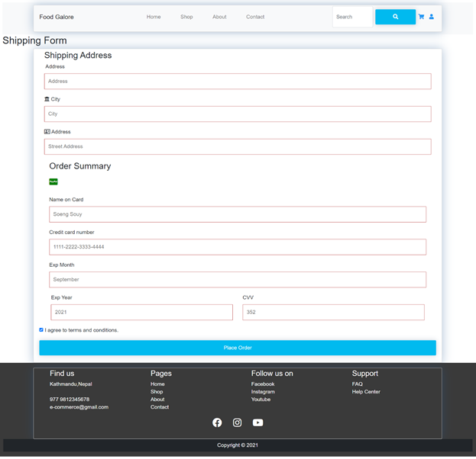
Product development

Slide 55
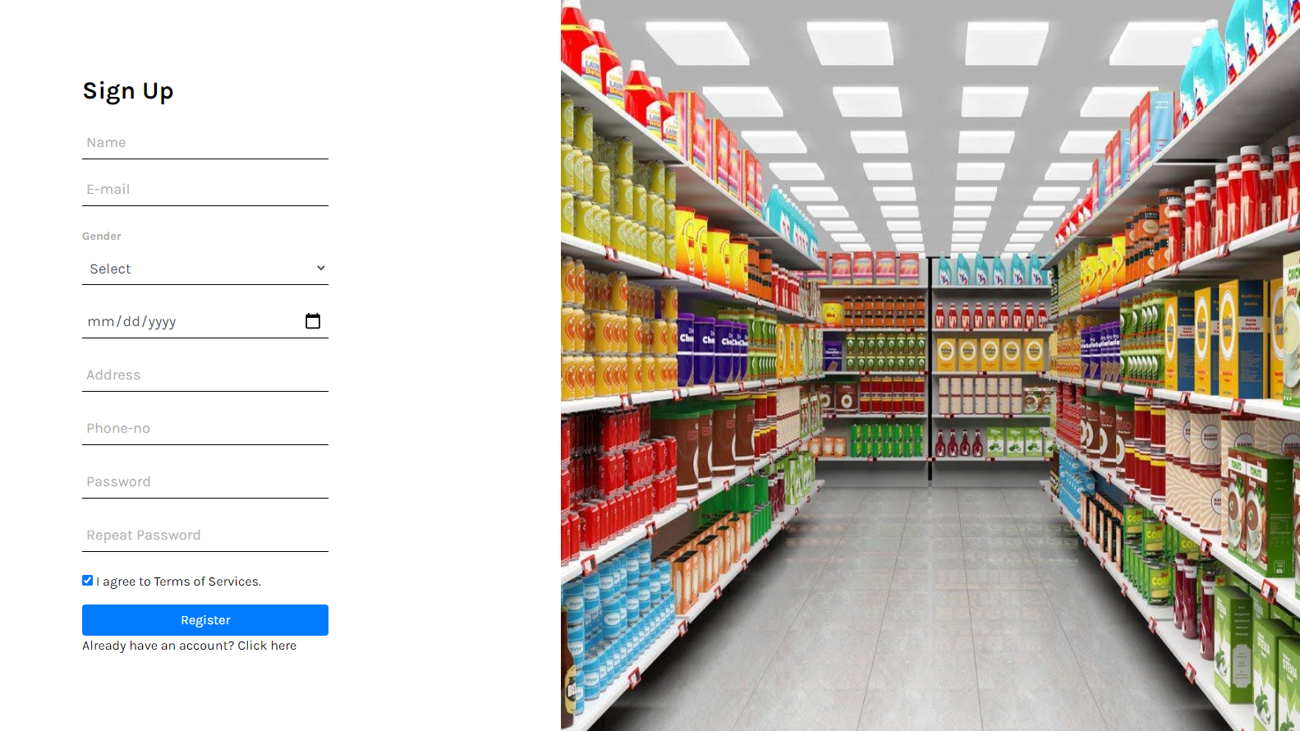
Product development

Slide 56
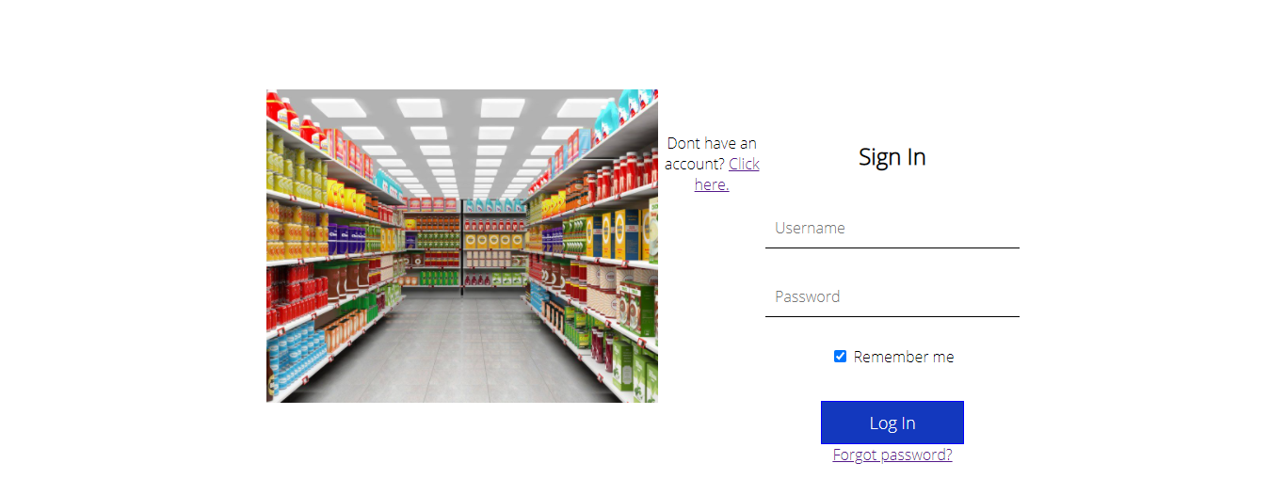
Product development

